Slide 1
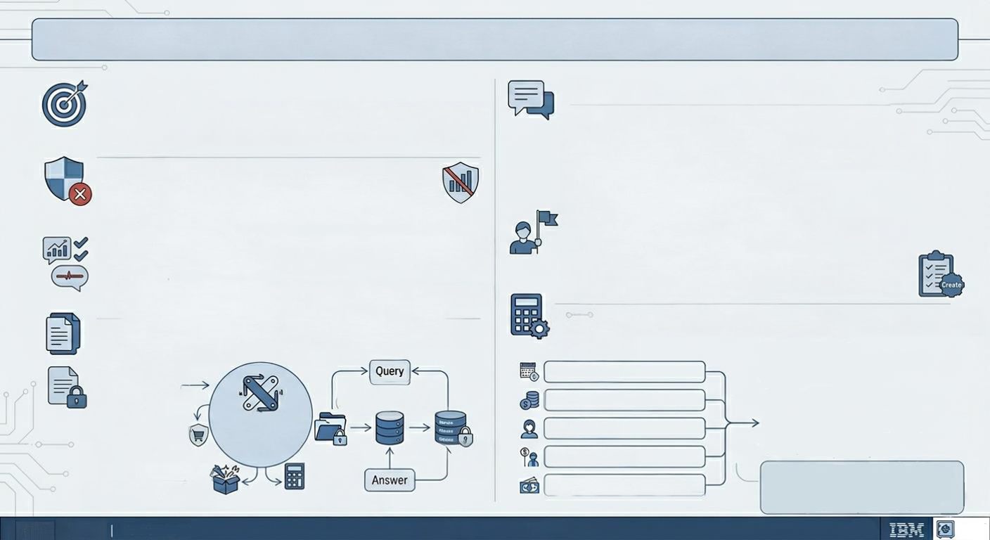
AGENTIC AI & MCP CHATBOT FOR BANKING/INSURANCE PORTAL
1. OBJECTIVE
4. AGENTIC CAPABILITIES & KEY PRACTICAL FEATURES
Empower users with a clear understanding of bank and insurance
products and policies available in their public site. Guide factual information retrieval for self-service.
ADVANCED SECURE KNOWLEDGE RETRIEVAL (RAG).
. Explain specific product and policy details securely.
. Answer complex customer policy queries with accuracy.
2. STRONG POLICY-BASED CONSTRAINTS
FACTUAL PRODUCT COMPARISON.
. Strict Non-Advisory Role Enforcement (MCP enforced).
NEW PRACTICAL USAGE CAPABILITIES:
. Detect and BLOCK all recommendation intents and product
purchase requests.
·
Focus only on neutral, factual comparison of products and options.
.
Prevent biased language like "You should buy ... " or "This is best
for you".
· ACTION: Intent Blocked. Immediate predefined non-advisory response
"I cannot recommend products. Here is comparing data ... "
1. Human-in-the-Loop (HITL) Workflow:
Agent can escalate complex or high-risk interactions
for review or intervention.
2. Automated Ticket Logging and Case Management:
Automated creation of tracking tickets for follow-up
actions and customer requests.
3. KNOWLEDGE-BASED INFORMATION RETRIEVAL
(SECURELY WITHIN BANK ENVIRONMENT).
5. FINANCIAL SIMULATION TOOLS (INFORMATIONAL ESTIMATES)
User Inputs:
Knowledge Base:
Annual Wage
Confidential Policy -
RAG System
(Knowledge Retrieval)
Documents
Monthly Spending
(Pre-loaded)
AGENTIC AI
ORCHESTRATOR
(Powered by MCP)
Policy Enforcement
Current Age
(Intent Blocking)
Secure Vector
Database
Retirement Age
Backend Document
Financial
Ingestion Tool
Calculator
Expected Retirement Income
(Updates Maintenance)
Tool
(Computation)
Date: May 5, 2026
IBM INTERNAL USE ONLY

